Slide 1
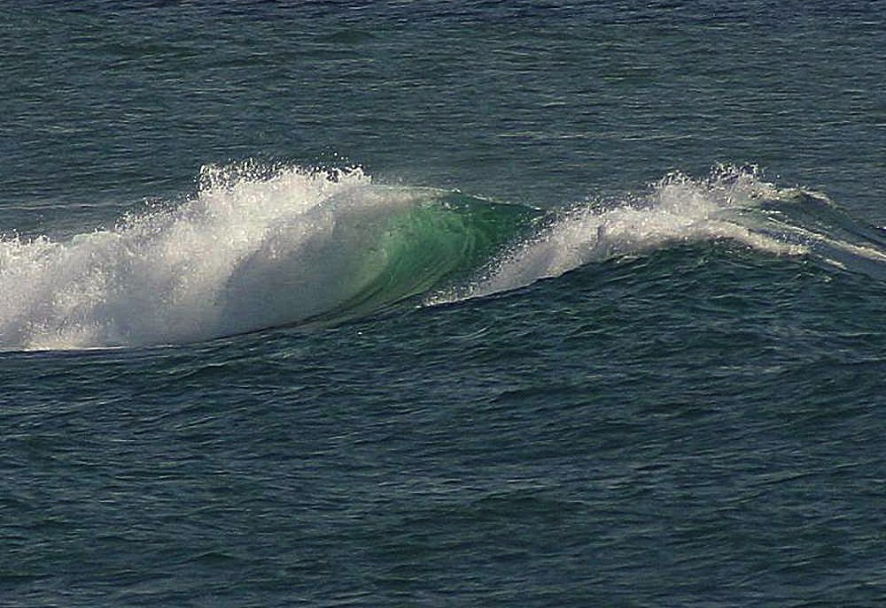
Renewable source of energy: Water
http://commons.wikimedia.org/wiki/File:Ocean_waves_(1).jpg

Slide 2
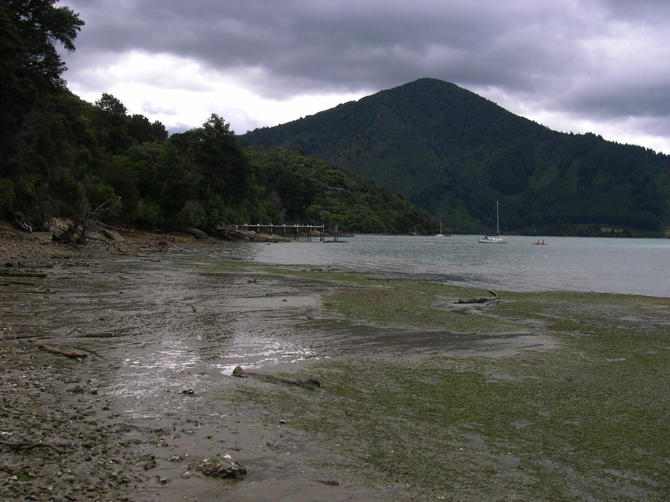
Tidal power: Energy from tides
http://commons.wikimedia.org/wiki/File:Low_tide_sea_beach.jpg

Slide 3
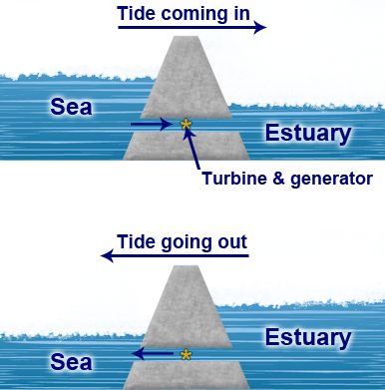
Tidal barrages
Tides move a huge amount of water twice each day.
Using this force could provide a great amount of energy.

Slide 4
How does it work?
A huge dam (called a ‘barrage’) is built across a river estuary.
When the tide goes in and out, the water flows through tunnels in the dam.
The movement of the tides can be used to turn a turbine, or it can be used to push air through a pipe, which then turns a turbine.

Slide 5
Advantages
Tides are predictable, so we can plan to have other power stations generating at those times when the tidal station is out of action.
Disadvantages
Tidal barrages can only generate when the tide is flowing in or out, e.g. only for 10 hours each day.

Slide 6
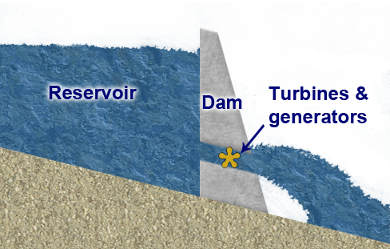
Hydro-electric power: Energy from falling water

Slide 7
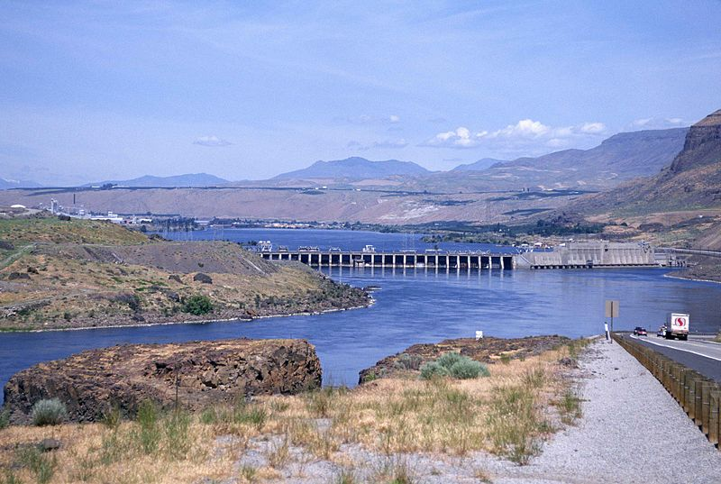
Hydro-electric dam
http://commons.wikimedia.org/wiki/File:Hydro_electric_dam.jpg

Slide 8
How does it work?
A dam is built to trap water, usually in a valley where there is an existing lake.
Water is allowed to flow through tunnels in the dam to turn turbines and drive generators.
Hydro-electric power stations can generate a great deal of power very cheaply.

Slide 9
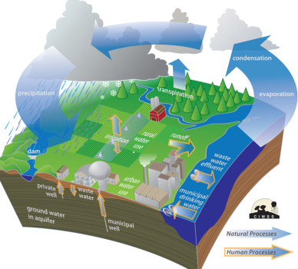
Water cycle keeps the dam supplied with water for free
‘Climate change may alter how water moves through the water cycle’ in Wisconsin's Changing Climate: Impacts and Adaptation (page 46). 2011. Wisconsin Initiative on Climate Change Impacts. Nelson Institute for Environmental Studies, University of Wisconsin-Madison and the Wisconsin Department of Natural Resources, Madison, Wisconsin. http://www.wicci.wisc.edu/report/2011_WICCI-Report.pdf

Slide 10
Advantages
Once the dam is built, the energy is virtually free.
No waste or pollution is produced.
Much more reliable than wind, solar or wave power. Electricity can be generated constantly.
Water can be stored above the dam ready to cope with peaks in demand.
Hydro-electric power stations can increase to full power very quickly, unlike other power stations.

Slide 11
Disadvantages
The dams are expensive to build. However, many dams are also used for flood control or irrigation, so building costs can be shared.
Building a large dam will flood a very large area upstream, causing problems for the people, animals and plants living there.
Finding a suitable site can be difficult — the impact on residents and the environment may be unacceptable.
Water quality and quantity downstream can be affected, which can have an impact on plant life.

